Slide 1
Guide to Networking Essentials,
6th Edition
Chapter 7: Network Hardware in Depth

Slide 2
Objectives
Describe the advanced features and operation of network switches
Describe routing table properties and discuss routing protocols
Explain basic and advanced wireless access point features
Select the most suitable NIC bus and features for a computer
Copyright © 2012 Cengage Learning. All rights reserved.

Slide 3
Network Switches in Depth
Switches work at the Data Link layer (Layer 2)
  Receive frames on one port and forward them out the port where the destination device can be found
Switches send broadcast frames out all ports
Each switch port is considered a collision domain (see figure on next slide)
  Switches do not forward collision information to any other ports
Switch ports can operate in full-duplex mode
  Allows connected devices to transmit and receive simultaneously, eliminating the possibility of a collision
Copyright © 2012 Cengage Learning. All rights reserved.

Slide 4
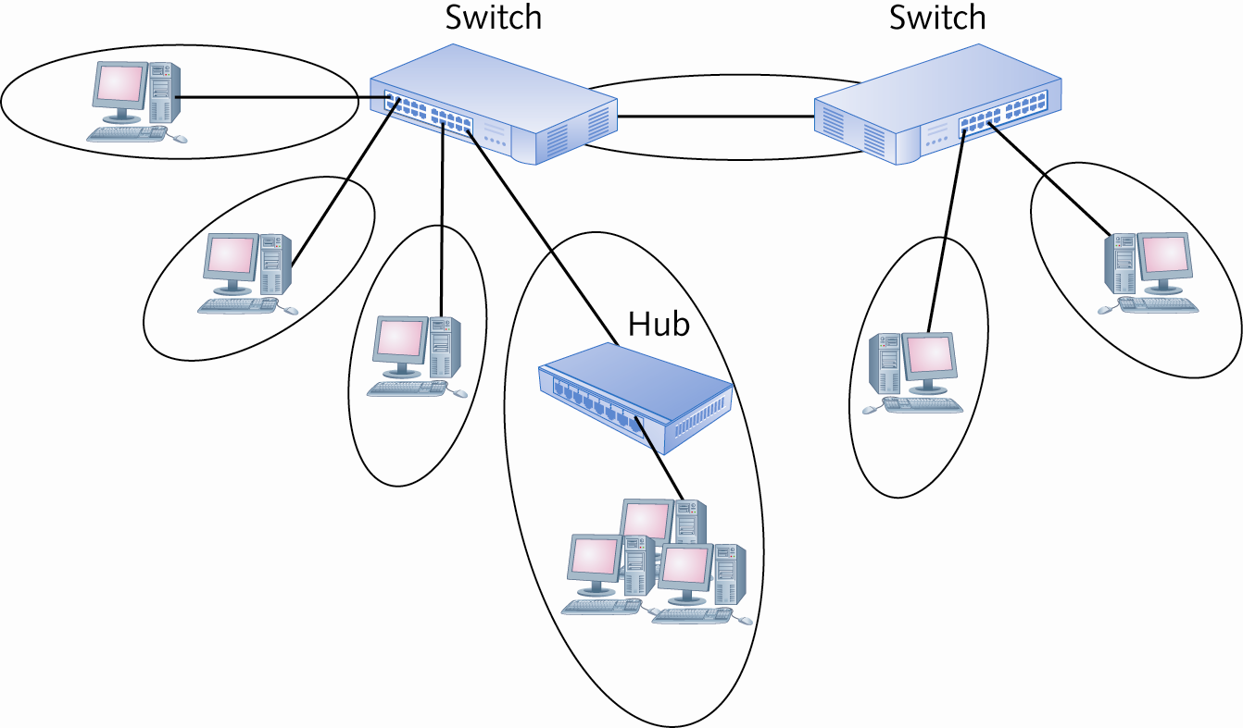
Network Switches in Depth
Each switch port is a collision domain
Copyright © 2012 Cengage Learning. All rights reserved.

Slide 5
Switch Port Modes of Operation
Ports on a typical 10/100 Mbps switch can usually operate in these modes:
  10 Mbps half-duplex
  100 Mbps half-duplex
  10 Mbps full-duplex
  100 Mbps full-duplex
Most switches run in auto-negotiate mode, which means the switch sets the mode to the highest performance setting the connected device supports
Auto-MDIX mode – switches transmit and receive pairs automatically so a straight-through or crossover cable can be used
Copyright © 2012 Cengage Learning. All rights reserved.

Slide 6
Creating the Switching Table
A switching table holds MAC address/port pairs that tell the switch where to forward a frame, based on the destination MAC address
When a switch is first powered on, its table is empty
As network devices send frames, the switch reads each frame’s source address and adds it to the table along with the port it was received from
If a frame’s destination address isn’t found in the switching table, the switch forwards the frame out all ports
Copyright © 2012 Cengage Learning. All rights reserved.

Slide 7
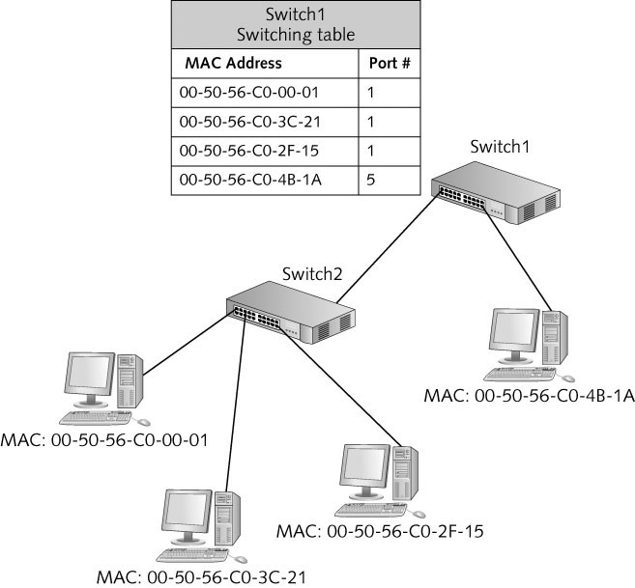
Creating the Switching Table
Switching tables can contain multiple MAC addresses per port
Copyright © 2012 Cengage Learning. All rights reserved.

Slide 8
Creating the Switching Table
Most switches include a number that indicates the number of MAC addresses the switch can hold in its table (8K MAC addresses supported)
Switching tables prevent stale entries by including a timestamp when an entry is created
  When a switch receives a frame from a device already in its table, it updates the entry with a new timestamp
The period of time a table keeps a MAC address is called the aging time
  If the timestamp isn’t updated within the aging time, the entry expires and is removed from the table
Copyright © 2012 Cengage Learning. All rights reserved.

Slide 9
Frame Forwarding Methods
Cut-through switching – switch reads only enough of the incoming frame to determine the frame’s source and destination address (fastest method)
  Disadvantage: no error checking
Store-and-forward switching – switch reads the entire frame into its buffers before forwarding it
  Switch examines the FCS field to make sure it contains no errors before forwarding the frame
Fragment-free switching – switch reads enough of the frame to guarantee that it’s at least the minimum size for the network type
Copyright © 2012 Cengage Learning. All rights reserved.

Slide 10
Advanced Switch Features
High-end switches, often referred to as “smart switches” and “managed switches,” can help make a network more efficient and reliable
The following slides are an overview of the most common features found in “smart switches”
Copyright © 2012 Cengage Learning. All rights reserved.

Slide 11
Advanced Switch Features
Multicast processing – Switches process multicast frames in one of two ways
  By treating them as broadcasts and sending them out all ports
    Used by low-end switches or those that have not been configured for it
  By forwarding the frames only to ports that have registered the multicast address
    Used by switches that support Internet Group Management Protocol (IGMP)
    Multicast MAC addresses always begin with 01:00:5E, leaving the rest of the address to identify a particular multicast application
Copyright © 2012 Cengage Learning. All rights reserved.

Slide 12
Advanced Switch Features
Spanning Tree Protocol – Enables switches to detect when there is a potential for a switching loop (occurs when a frame is forwarded from one switch to another in an infinite loop)
  When a possible loop is detected, one of the switch ports goes into blocking mode, preventing it from forwarding frames that would create a loop
  If the loop configuration is broken, the switch that was in blocking mode resumes forwarding frames
  The next slide shows an example of a switching loop
Simulation 15 – STP prevents switching loops
Copyright © 2012 Cengage Learning. All rights reserved.

Slide 13
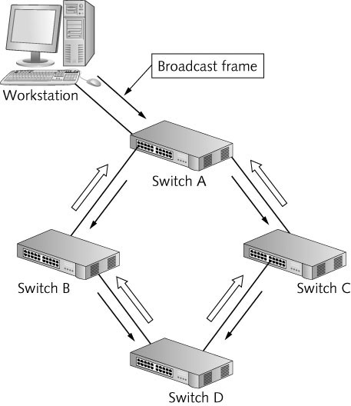
Advanced Switch Features
Copyright © 2012 Cengage Learning. All rights reserved.

Slide 14
Advanced Switch Features
Virtual Local Area Networks (VLANS) – enable you to configure one or more switch ports into separate broadcast domains
  It’s like separating a switch into two or more switches that aren’t connected to one another
  A router is needed to communicate between VLANs
  Improves management and security of the network and gives more control of broadcast frames
  Allows administrators to group users and resources logically instead of by physical location
Copyright © 2012 Cengage Learning. All rights reserved.

Slide 15
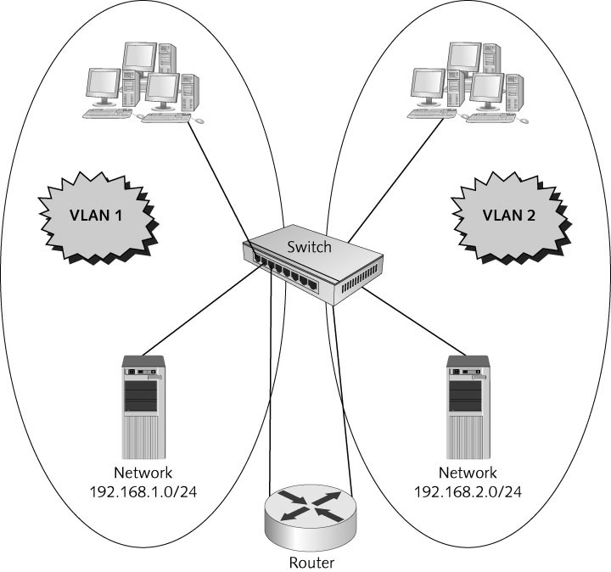
Advanced Switch Features
  VLANs logically group users and resources from different physical locations
  A trunk port is a switch
  Port configured to carry
  Traffic from all VLANs to
  another switch or router
  Simulation 16 – How switches use trunk ports with VLANs
Copyright © 2012 Cengage Learning. All rights reserved.

Slide 16
Advanced Switch Features
Factors to consider before using VLANs
  Overuse of VLANs can end up costing you more than it benefits you
  More VLANs mean more logical networks so your network will be more complicated
  Every VLAN you create requires a corresponding router interface
  Routers are slower devices, so performance can decrease with the addition of more VLANs
  More router interfaces mean additional IP networks, which is likely to require subnetting your existing network
Copyright © 2012 Cengage Learning. All rights reserved.

Slide 17
Advanced Switch Features
Switch Port Security – In some public buildings, network jacks with connections to switches are often available to public users, who can easily plug in a laptop that contain viruses, hacker tools, and other malware
  A switch with port security features can help prevent this type of connection
  Enables an administrator to limit how many and which MAC addresses can connect to a port
  If an unauthorized computer attempts to connect, the port can be disabled and a message can be sent to the administrator to alert them of the intrusion
Copyright © 2012 Cengage Learning. All rights reserved.

Slide 18
Routers in Depth
Routers operate at the Network layer (Layer 3) and work with packets
  Connect separate logical networks to form an internetwork
  Broadcast frames are not forwarded to other router ports (other networks)
  Routers can be used to create complex internetworks with multiple paths creating fault tolerance and load sharing
  All processing done by routers depends on the following features found on most routers:
    Router interfaces
    Routing tables
    Routing protocols
    Access control lists
Copyright © 2012 Cengage Learning. All rights reserved.

Slide 19
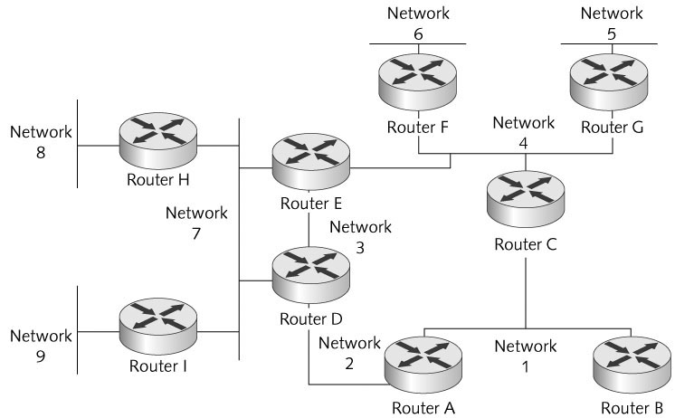
Routers in Depth
Copyright © 2012 Cengage Learning. All rights reserved.

Slide 20
Router Interfaces
Routers must have two or more interfaces (ports) in order to take packets coming from one network and forward them to another network
When a router interface receives a frame, it compares the destination MAC address with the interface’s MAC address
  If they match, the router strips the frame header and trailer and reads the packet’s destination IP address
  If the IP address matches it processes the packet
  If the IP address does not match, the router consults its routing table to determine how to get the packet to the its destination
  The process of moving a packet from the incoming interface to the outgoing interface is called packet forwarding
Copyright © 2012 Cengage Learning. All rights reserved.

Slide 21
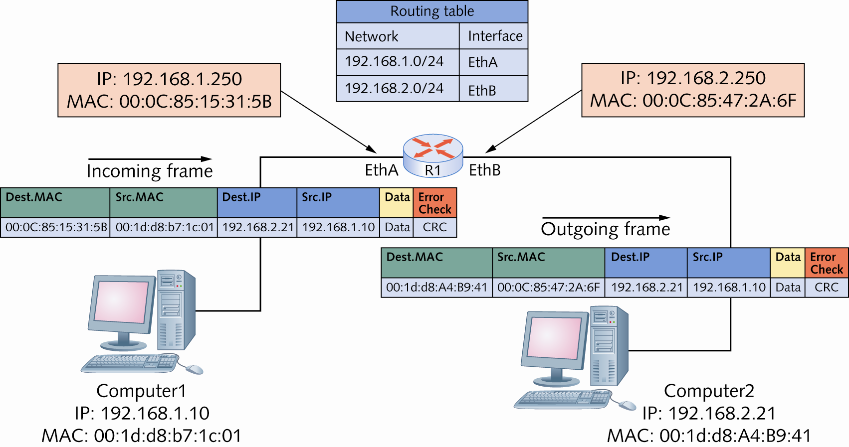
Router Interfaces
Packets are forwarded from one network to another
Copyright © 2012 Cengage Learning. All rights reserved.

Slide 22
Routing Tables
Routing tables are composed of network address and interface pairs that tell the router which interface a packet should be forwarded to
Most routing tables contain the following for each entry:
  Destination network: Usually expressed in CIDR notation such as 172.16.0.0/16
  Next hop: The next hop indicates an interface name or the address of the next router in the path to the destination
    Total number of routers a packet must travel through is called the hop count
  Metric: Numeric value that tells the router how “far away” the destination network is (also called cost or distance)
Copyright © 2012 Cengage Learning. All rights reserved.

Slide 23
Routing Tables
Contents of routing tables (cont.):
  How the route is derived: This field tells you how the route gets into the routing table (one of 3 ways)
    Network is connected directly
    Administrator enters the route information manually (called a static route)
    Route information is entered dynamically, via a routing protocol
  Timestamp: Tells the router how long it has been since the routing protocol updated the dynamic route
Simulation 17 – Routers use multiple paths in an internetwork
Copyright © 2012 Cengage Learning. All rights reserved.

Slide 24
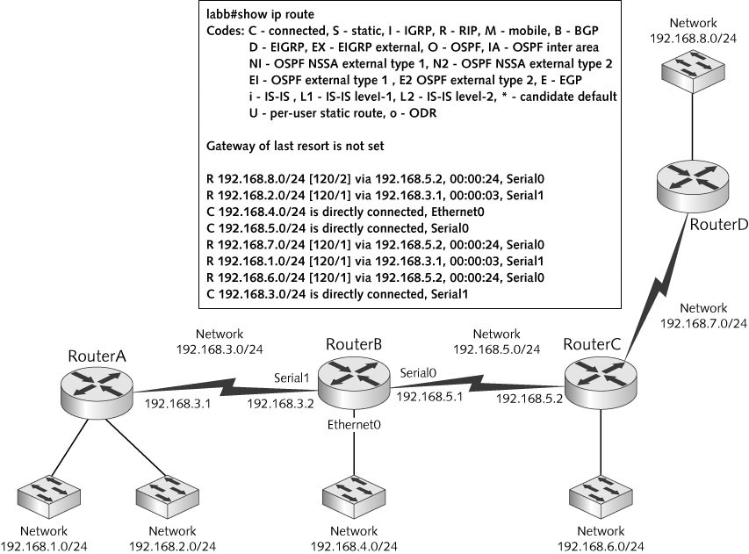
Routing Tables
Copyright © 2012 Cengage Learning. All rights reserved.

Slide 25
Routing Protocols
Routing protocol – A set of rules that routers use to exchange information so that all routers have accurate information about an internetwork to populate their routing tables
Two main types of routing protocols
  Distance-vector protocols share information about an internetwork’s status by copying a router’s routing table to other routers (routers sharing a network are called neighbors)
    Routing Information Protocol (RIP) and RIPv2 are most common
  Link-state protocols share information with other routers by sending the status of all their interface links to other routers
    Open Shortest Path First (OSPF) is most common
Copyright © 2012 Cengage Learning. All rights reserved.

Slide 26
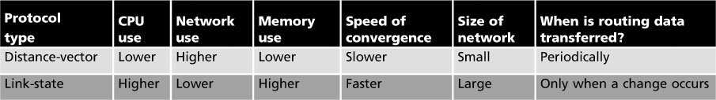
Routing Protocols
Distance-vector versus link-state routing protocols
Speed of convergence refers to how fast the routing tables of all routers in an internetwork are updated when a change in the network occurs
Copyright © 2012 Cengage Learning. All rights reserved.

Slide 27
Routing Protocols
Routing protocols are not a necessity in all situations, as static routes can be entered in a routing table manually. Consider the following:
  Does the network change often? If so, a routing protocol is probably a good choice
  Are there several alternate paths to many of the networks in the internetwork? If so, a routing protocol can reroute around down links or congested routes automatically
  Is the internetwork large? A routing protocol builds and maintains routing tables automatically
Copyright © 2012 Cengage Learning. All rights reserved.

Slide 28
Access Control Lists
Access Control List (ACL) – A set of rules configured on a router’s interface for specifying which addresses and which protocols can pass through an interface and to which destinations
When an ACL blocks a packet it is called packet filtering
Usually configured to block traffic based on:
  Source address
  Destination address
  Protocol
Addresses can be specific IP addresses or network numbers and filtering can be done on either source or destination address or both
Copyright © 2012 Cengage Learning. All rights reserved.

Slide 29
Wireless Access Points in Depth
Basic wireless settings on most APs define the settings a client wireless device needs to connect to an AP:
  Wireless network mode: allows you to choose which 802.11 standard the AP should operate under
  Wireless network name (SSID): when an AP is shipped, the SSID is set to a default value – it is recommended that you change it upon setup
  Wireless channel: recommended that you set your channels five channels apart, such as 1, 6, and 11
  SSID broadcast status: by default, APs are configured to transmit the SSID so that any wireless device in range can see the network
Copyright © 2012 Cengage Learning. All rights reserved.

Slide 30
Wireless Security Options
Most APs offer the following security options:
  Encryption
  Authentication
  MAC filtering
  AP isolation
Encryption – all private networks should use this
  Most common protocols are Wired Equivalent Privacy (WEP), Wi-Fi Protected Access (WPA), and Wi-Fi Protected Access 2 (WPA2)
  Use the highest level of security your systems support (all devices must use the same protocol)
Copyright © 2012 Cengage Learning. All rights reserved.

Slide 31
Wireless Security Options
Authentication – If used, users must enter a username and password to access the wireless network
  APs that support authentication usually support the Remote Dial-In User Service (RADIUS) protocol
MAC filtering – enables you to restrict which devices can connect to your AP
  Add the MAC addresses of the wireless devices allowed to access your network to a list on the AP
AP isolation – creates a separate virtual network for each client connection
  Clients can access the Internet but can’t communicate with each other
Copyright © 2012 Cengage Learning. All rights reserved.

Slide 32
Advanced Wireless Settings
Common advanced settings:
  Adjustable transmit power: Lets you control the power and range of the wireless network signal
  Multiple SSIDs: Two or more wireless networks can be created with different security settings
  VLAN support: To assign wireless networks to wired VLANs
  Traffic priority: If your AP is configured for multiple networks you can assign a priority to packets coming from each network
  Wi-Fi Multimedia: Provides Quality of Service (QoS) settings for multimedia traffic, giving priority to streaming audio or video
  AP modes: An AP can be set to operate as a traditional access point, a repeater, or a wireless bridge
Copyright © 2012 Cengage Learning. All rights reserved.

Slide 33
Network Interface Cards in Depth
PC Bus Options – a bus makes the connections between a computer’s vital components
  The faster the bus, the faster data can be transferred between these components, which makes for a faster system
  NICs are considered I/O devices and can be built into the motherboard or added as an expansion card
  Peripheral Component Interconnect (PCI) bus became the default bus standard
    Most implementations are 32-bit and operate at 33 MHz with a maximum data transfer rate of 133 MBps
    First bus to accommodate the Microsoft Plug-and-Play architecture
Copyright © 2012 Cengage Learning. All rights reserved.

Slide 34
Network Interface Cards in Depth
PC Bus Options (continued):
  PCI-X is backward-compatible with PCI but supports speeds from 66 MHz to 533 MHz, providing data transfers from
  500 MBps to more than 4 GBps
    Accommodated developments in faster network cards
  PCIe – uses a high-speed serial communication protocol of one or more lines or lanes
    Each lane can operate at 250 MBps in each direction
    PCIe 2.0 provides data rates of 500 MBps
    PCIe is now the dominant bus technology
Copyright © 2012 Cengage Learning. All rights reserved.

Slide 35
Network Interface Cards in Depth
PC Bus Options (continued):
  PCMCIA: credit card-sized expansion cards used mainly to add functionality to laptop computers
    Cardbus – operates at 33 MHz and provides up to 132 MBps data transfer rates
    ExpressCard – uses PCIe technology to provide data transfer rates up to 500 MBps
  USB: Universal Serial Bus comes in three versions: USB 1.0, USB 2.0, USB 3.0 and is now a standard interface on PCs and MACs
    Data rates increased with the release of each version
Copyright © 2012 Cengage Learning. All rights reserved.

Slide 36
Advanced Features of NICs
If a NIC is slow, it can limit network performance
When selecting a network adapter, first identify the physical characteristics the card must match (type of bus, type of network technology, type of connector needed to connect to media)
Hardware-enhancement options:
  Shared adapter memory: the adapter’s buffers map directly to RAM on the computer
  Shared system memory: a NIC’s onboard processor selects a region of RAM on the computer and writes to it as though it were buffer space on the adapter
Copyright © 2012 Cengage Learning. All rights reserved.

Slide 37
Advanced Features of NICs
Hardware-enhancement options (continued):
  Bus mastering: permits a network adapter to take control of the computer’s bus to initiate and manage data transfers to and from the computer’s memory
  RAM buffering: means a NIC includes additional memory to provide temporary storage for incoming and outgoing network data that arrives at the NIC faster than it can be sent out
  Onboard co-processors: enable the card to process incoming and outgoing network data without requiring service from the CPU
  QOS: allows prioritizing time-sensitive data
  Automatic link aggregation: enables you to install multiple NICs in one computer and aggregate the bandwidth
Copyright © 2012 Cengage Learning. All rights reserved.

Slide 38
Advanced Features of NICs
Hardware-enhancement options (continued):
  Improved fault tolerance by installing a second NIC
    Failure of the primary NIC shifts network traffic to the second NIC
  Advanced Configuration Power Management Interface (ACPI) offers wake-on LAN, which allows an administrator to power on a PC remotely by accessing the NIC through the network
  Preboot Execution Environment (PXE) allow a computer to download an OS instead of booting it from a local hard drive
    Used on diskless workstations (“thin clients”) that do not store the OS locally
Typical desktop computers with basic features are usually adequate.
Servers do warrant some of these high-end features
Copyright © 2012 Cengage Learning. All rights reserved.

Slide 39
Chapter Summary
Network switches use auto-negotiate mode to determine the link speed and duplex mode
Switching tables can hold many more MAC addresses than ports
Switches forward frames by using a variety of methods: cut-through, fragment-free, and store-and-forward
Advanced features, such as VLANs, STP, multicast support, and port security are found on smart switches
Routing tables contain destination networks, next hop addresses, metrics, methods used to derive routes, and timestamps
Copyright © 2012 Cengage Learning. All rights reserved.

Slide 40
Chapter Summary
Routing protocols populate routing tables dynamically. The most common type of routing protocols are distance-vector and link-state
Access points have the following basic settings: wireless mode, SSID, and wireless channel
Higher-end APs can support advanced features, such as multiple SSIDs, adjustable transmit power, VLANs, QoS, and repeater and bridge modes
NIC selection includes the PC bus
Some advanced NIC features to consider include RAM buffering, onboard co-processors, automatic link aggregation, and multiple ports for fault tolerance
Copyright © 2012 Cengage Learning. All rights reserved.

